Slide 1
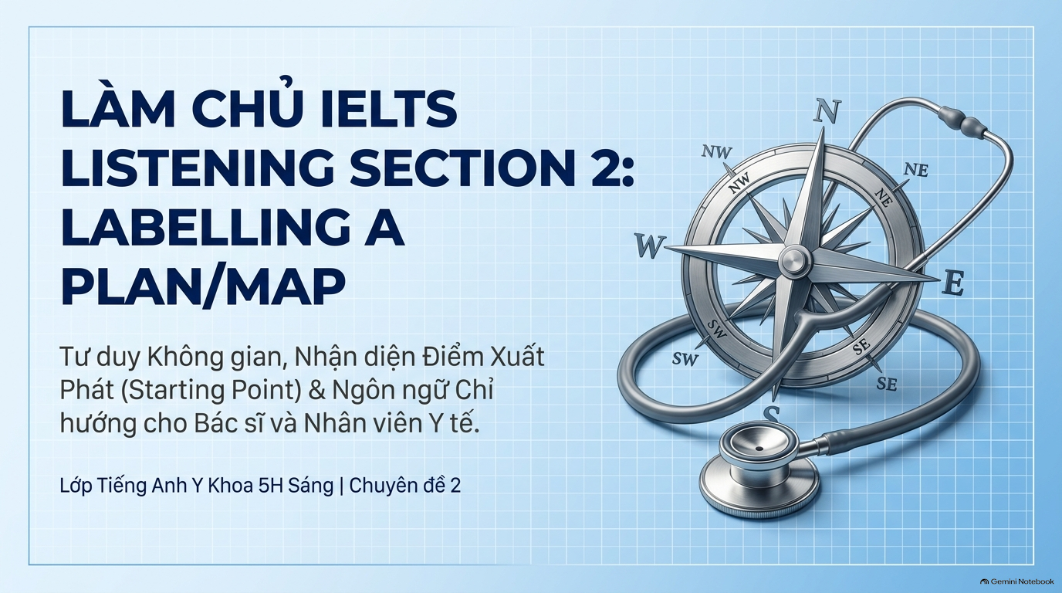

Slide 2
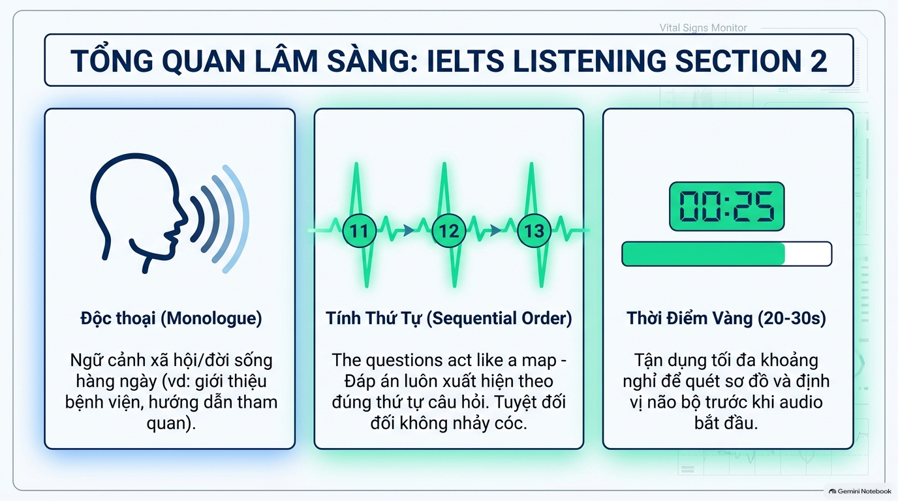

Slide 3
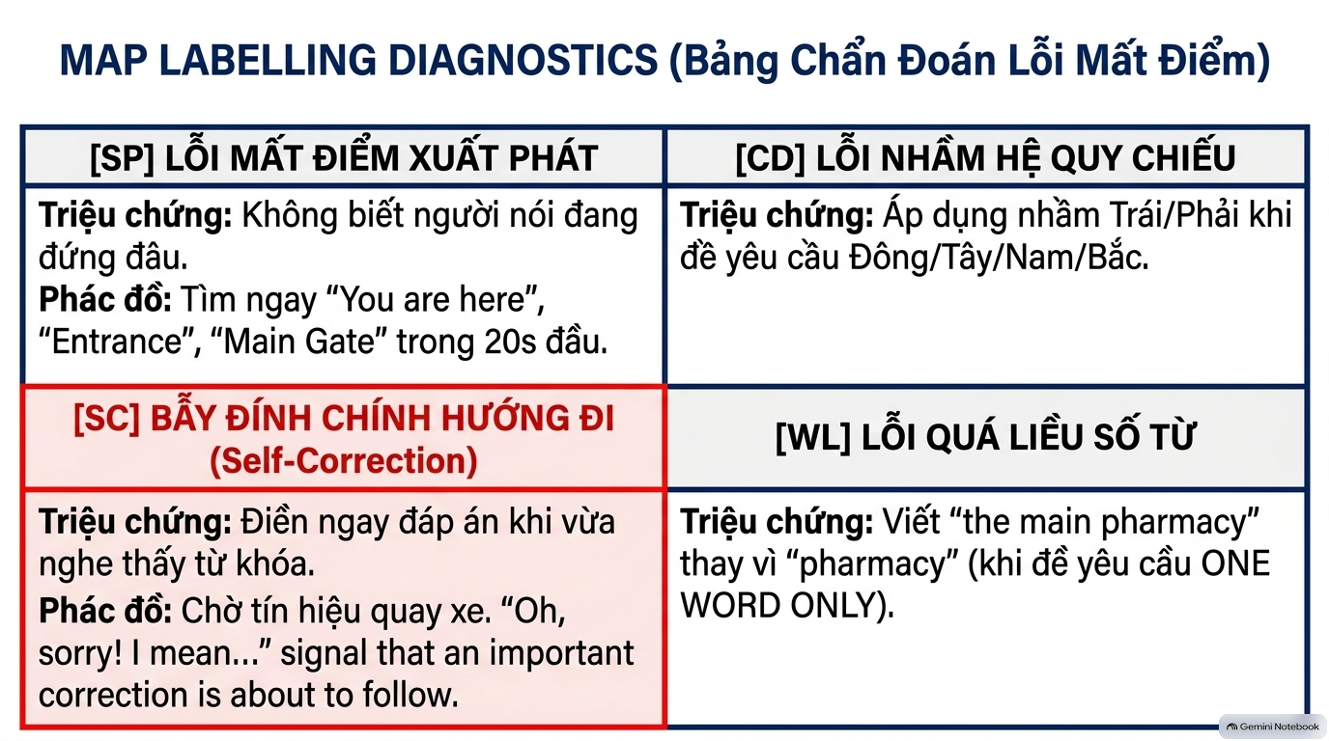

Slide 4
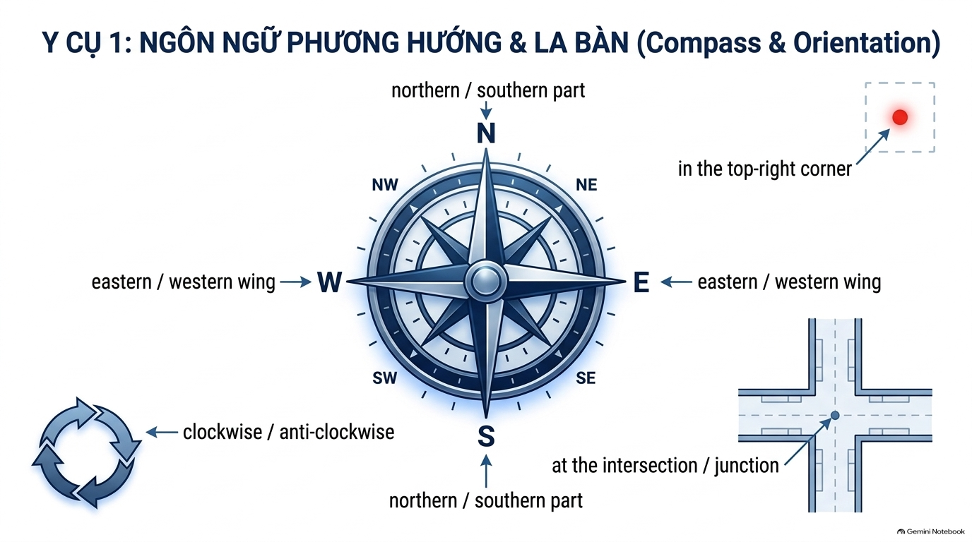

Slide 5
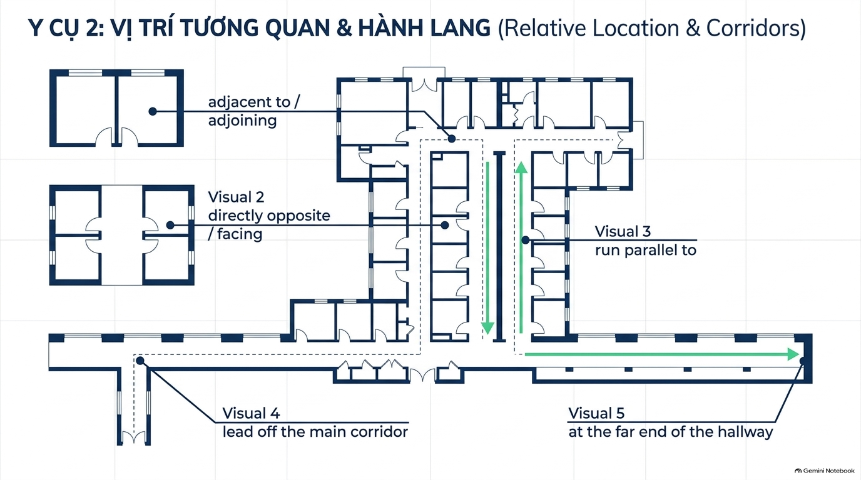

Slide 6
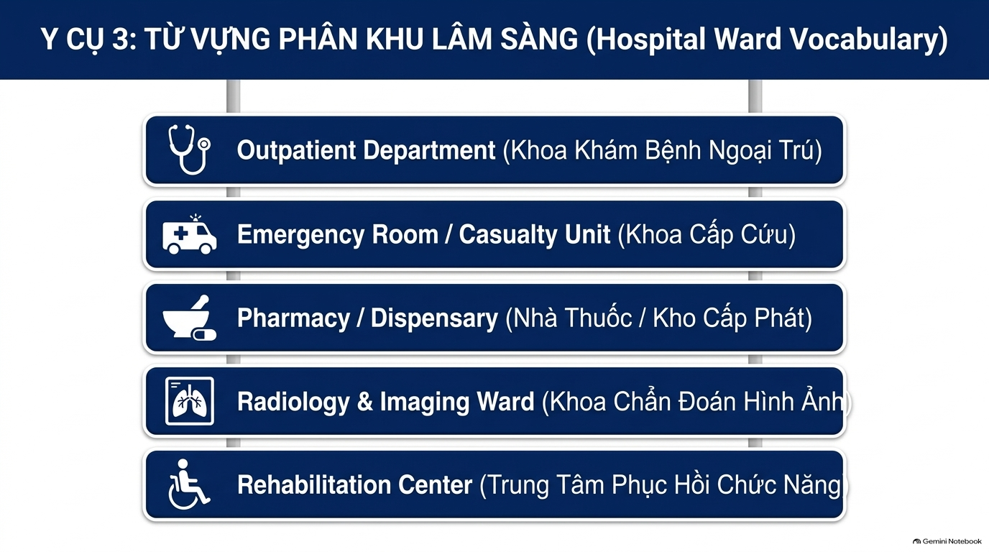

Slide 7
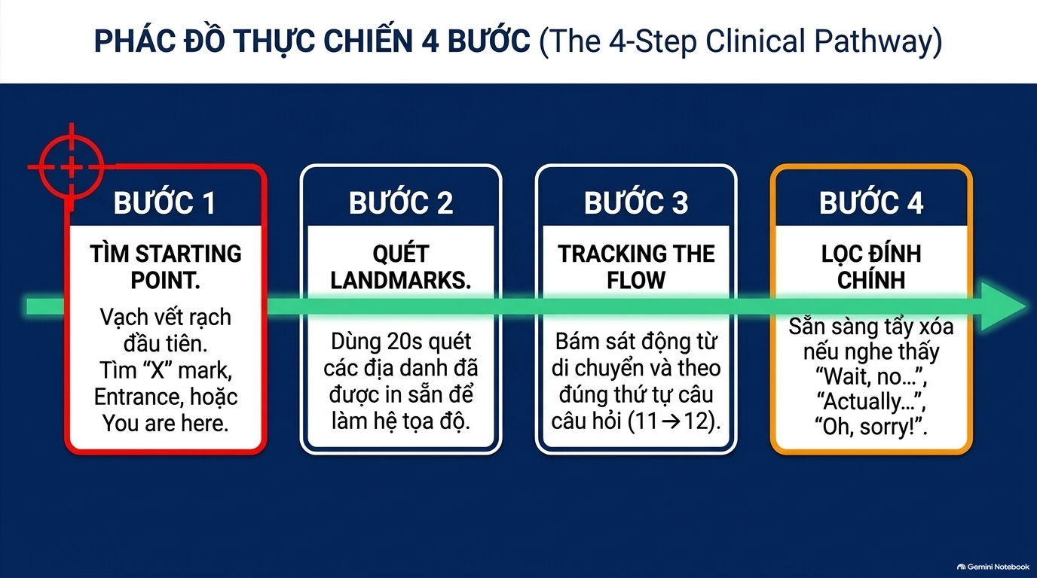

Slide 8
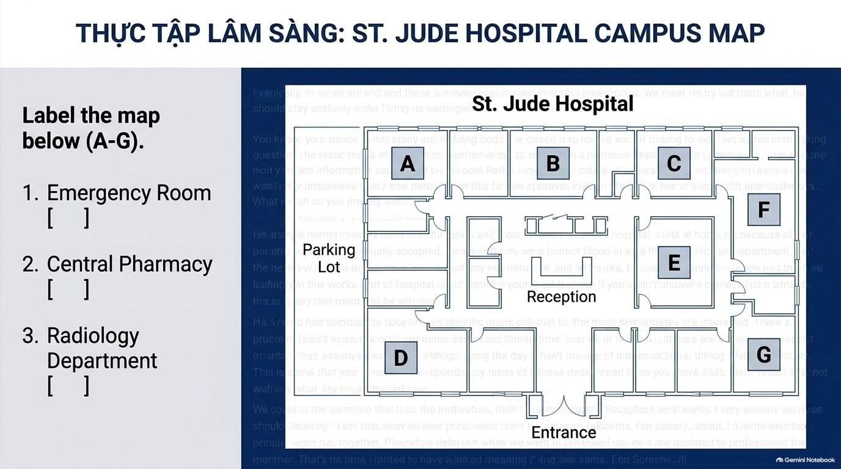

Slide 9
AUDIO SCRIPT:
Welcome to St. Jude Hospital. As you stand at the Main Entrance facing the Reception Desk, let me guide you through our main facilities.
First, if you have an urgent medical case, the Emergency Room is located immediately on your left as you enter, right next to the visitor parking lot.
Next, to collect your prescribed medication, you'll need the Central Pharmacy. Walk past the Reception Desk and head straight ahead towards the Central Courtyard.
The pharmacy is situated directly opposite the reception, right in the heart of the building. Oh, wait, please note that for inpatient supplies you need the east wing, but for general prescriptions, this central building is the one.
Finally, for X-rays and CT scans, the Radiology Department is at the far end of the West corridor. So from Reception, turn left, walk all the way down to the top-left corner of the campus, and you'll find it right at the end.
1- A
2- C
3 - B

Slide 10
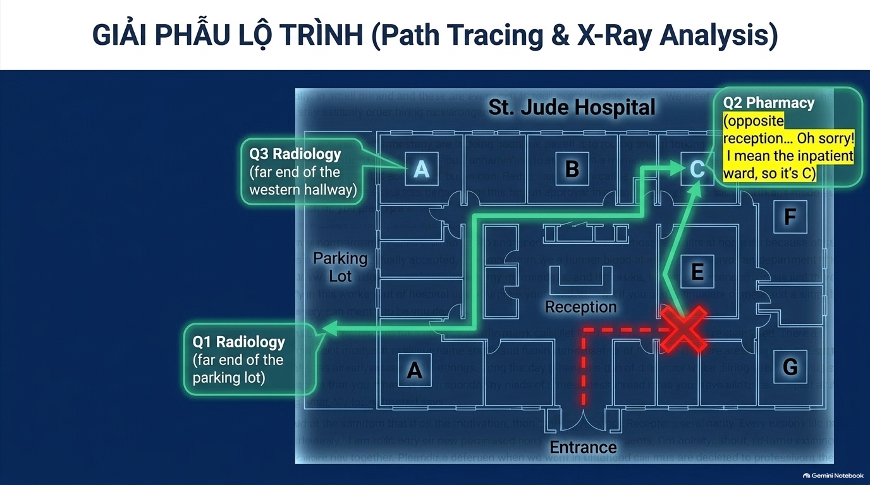

Slide 11
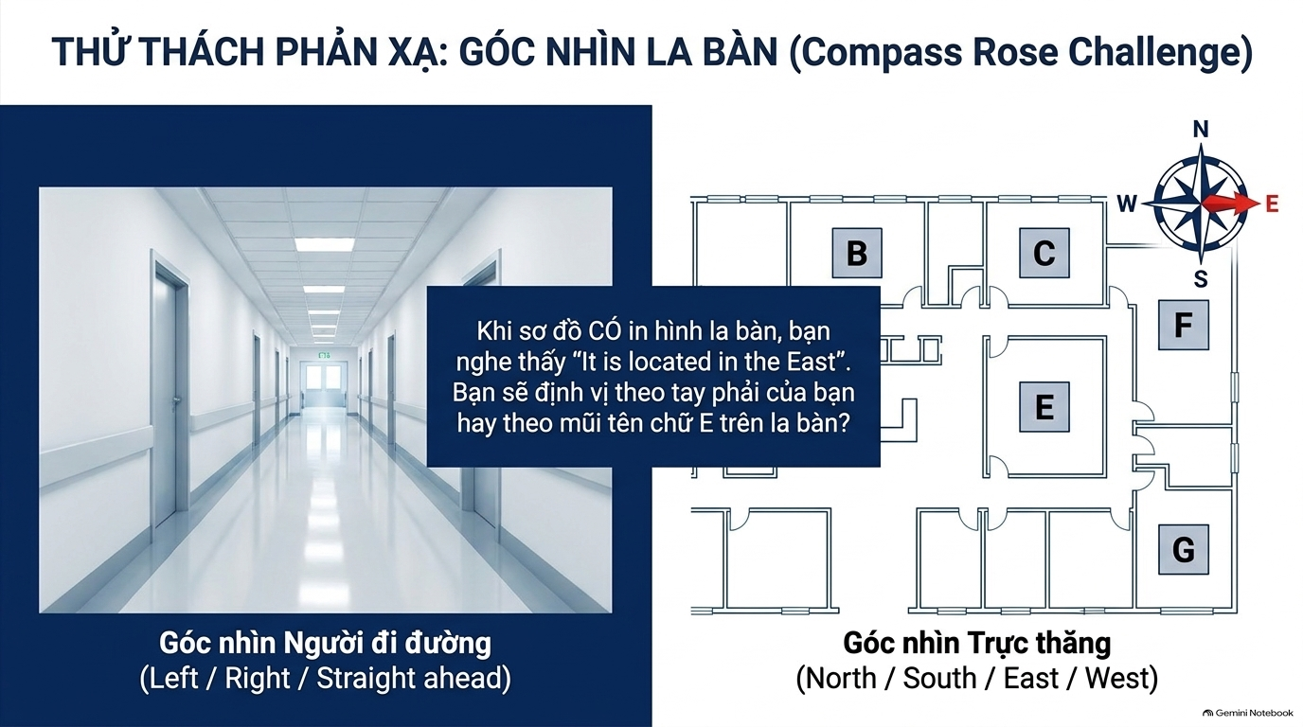

Slide 12
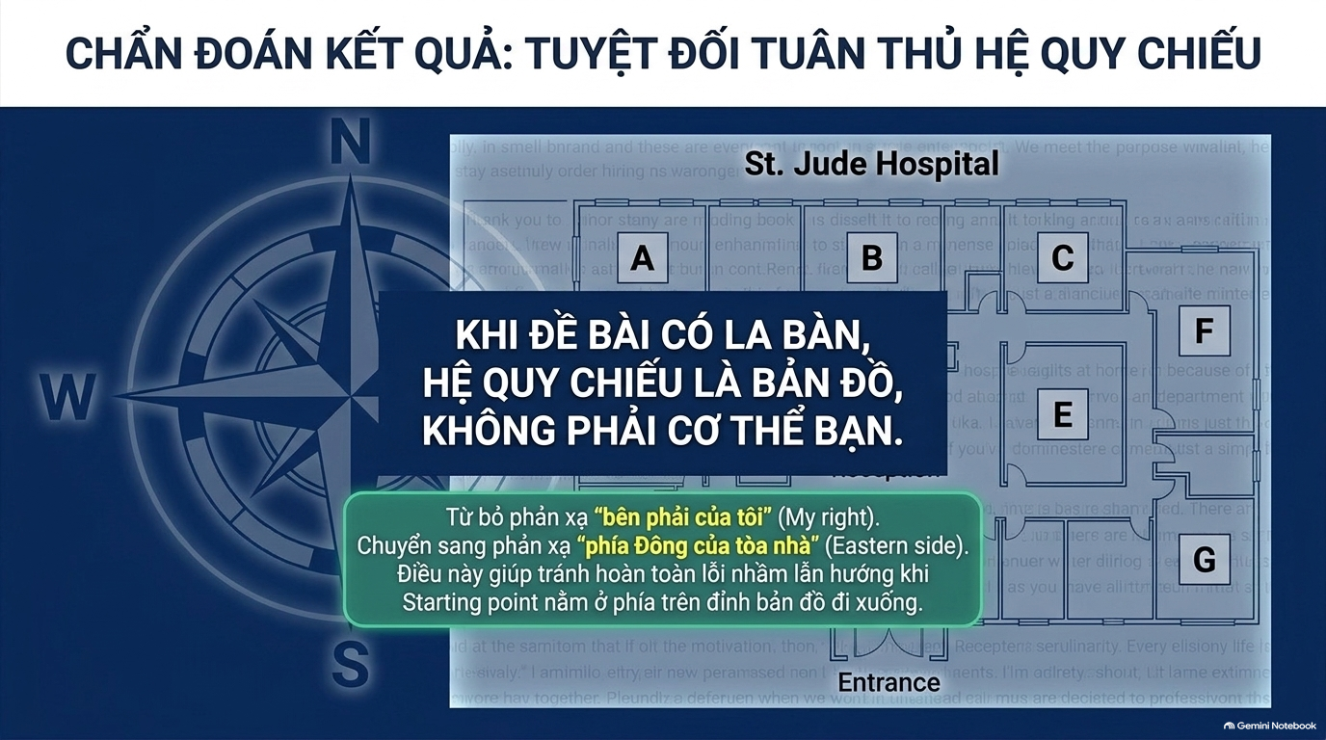

Slide 13
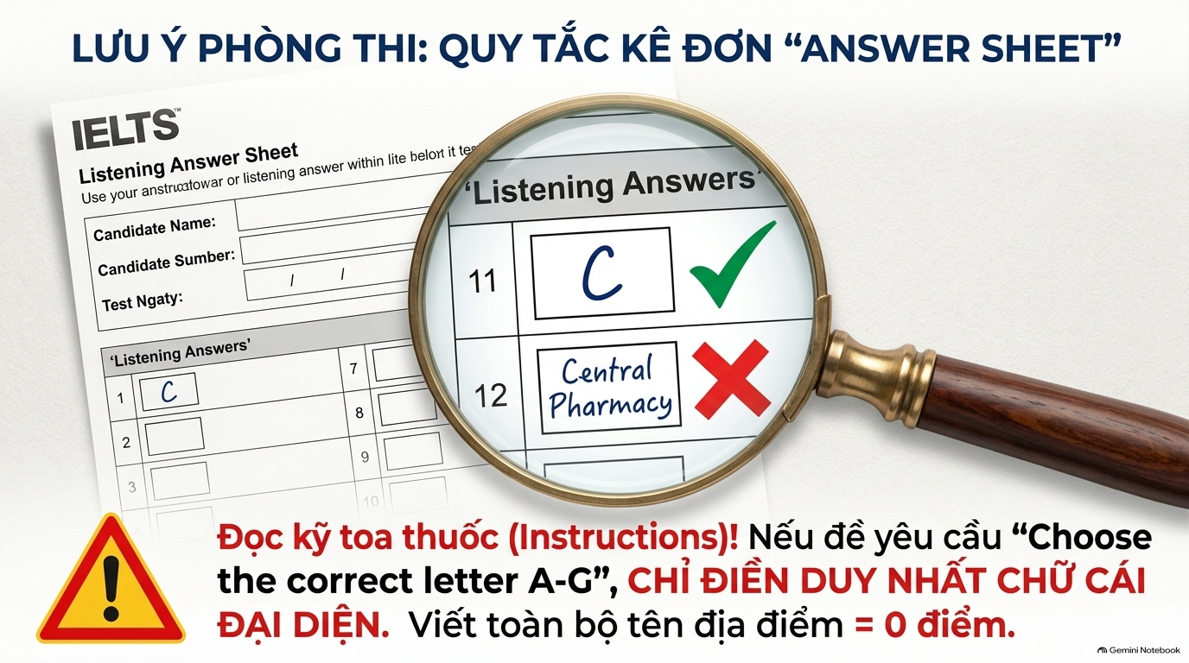

Slide 14
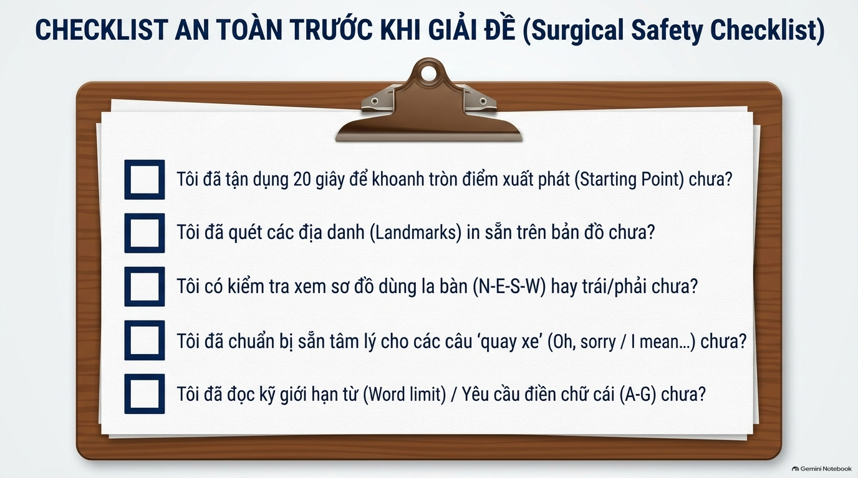

Slide 15


Slide 16


